Slide 1
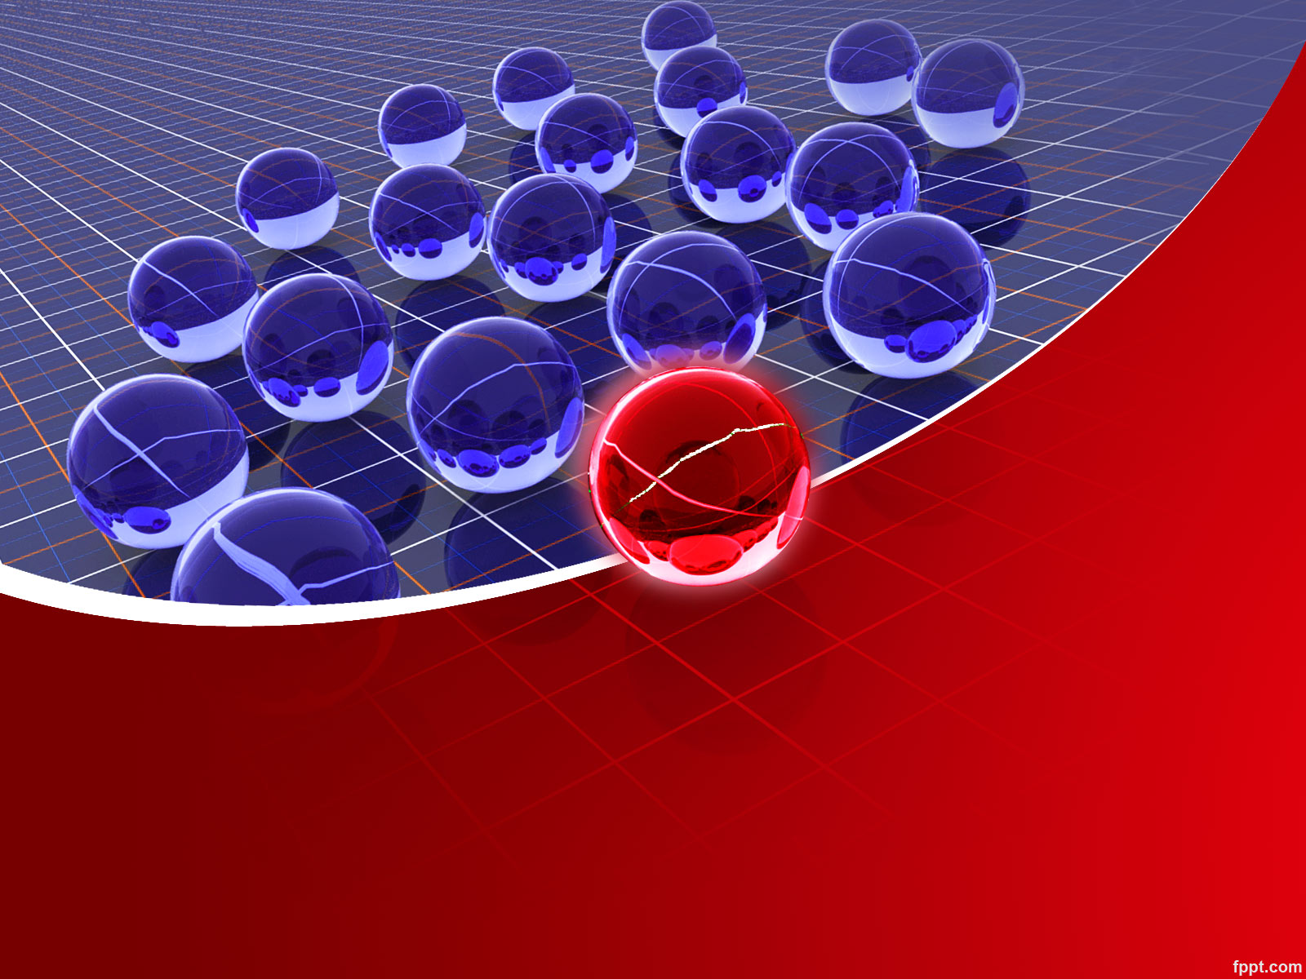
Enterprise Resource Planning

Slide 2
UNIT - I
Overview of enterprise systems
Evolution
Risks and
Benefits
Fundamental technology
Issues to be consider in planning design and implementation of cross functional integrated ERP systems.

Slide 3
Enterprise
An enterprise is a group of people with a common goal, which has certain resources at its disposal to achieve this goal. In traditional approach , the organization is divided into different nits based on the functions they PERFORM……

Slide 4

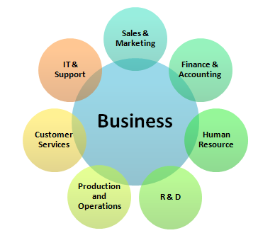
ENTERPRISE

Slide 5
ENTERPRISE
These departments function in isolation and have their own systems of data collection and analysis.
In enterprise way the entire organization is considered a system and all departments are its sub system, each sub system knows what others are doing , why they are doing and what should be done to move the company towards common goal.
If the information that is generated is accurate, timely and relevant, then the systems will go a long way in helping the organization to realize its goals

Slide 6

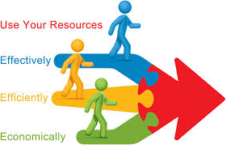
RESOURCE

Slide 7
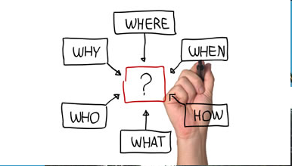

PLANNING

Slide 8
ENTERPRISE RESOURCE PLANNING
ERP integrates the information system of an organization and automates most of the functions. The activities supported by ERP system include all core functions of an organization, including financial management, human resource management, and operations

Slide 9
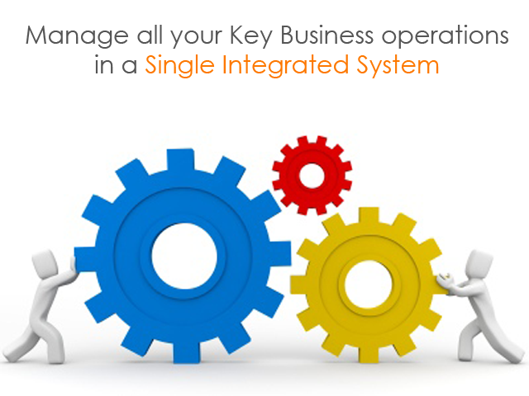
DEFINITION - ERP
Enterprise resource planning (ERP) Is business process management software that allows an organization to use a system of integrated applications to manage the business and automate many back office functions related to technology, services and human resources. ERP software integrates all facets of an operation, including product planning, development, manufacturing, sales and marketing.

Slide 10
ENTERPRISE RESOURCE PLANNING
The ERP system definition, then, would be a set of software applications that organize, define and standardize the business processes necessary to effectively plan and control an organization. Essentially, ERP applications are a computer model of your business, embodying the products and processes, information flow, procedures, and relationships between functions and activities.
Example: A software package that provides both payroll and accounting functions could technically be considered an ERP software package

Slide 11
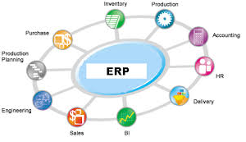
ENTERPRISE RESOURCE PLANNING

Slide 12
How Do ERP Systems Work?
Managers and
Stakeholders
Financial
Applications
Human
Resource
Management
Applications
Reporting
Applications
Sales and
Delivery
Applications
Central
Database
Manufacturing
Applications
Sales Force
And Customer
Service Reps
Back-office
Administrators
And Workers
Customers
Suppliers
Service
Applications
Employees
Human
Resource
Management
Applications
Inventory
And Supply
Applications

Slide 13




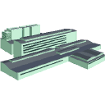


An ERP Example: Before ERP
Orders
Parts
Sends report
Customer
Demographic
Files
Sales Dept.
Customers
Checks for Parts
Calls back “Not in stock”
Accounting
Files
“We ordered the parts”
Accounting
Invoices
accounting
Sends report
Sends report
Ships parts
Vendor
Warehouse
Order is placed
with Vendor
“We Need parts #XX”
Inventory
Files
Purchasing
Files
“We ordered the parts”
Purchasing

Slide 14
An ERP Example: After ERP
Orders
Parts
Inventory Data
If no parts,
order is placed
through DB
Customers
Sales Dept.
Accounting
Financial Data exchange;
Books invoice against PO
Order is submitted
to Purchasing.
Purchasing record
order in DB
Database
Books inventory
against PO
Order is placed
with Vendor
Vendor
Warehouse
Purchasing
Ships parts
And invoices accounting

Slide 15
The Ideal ERPSystem
An ideal ERP system is when a single database is utilized and contains all data for various software modules. These software modules can include:
1. Manufacturing: Some of the functions include; engineering, capacity, workflow management, quality control, bills of material, manufacturing process, etc.
2. Financials: Accounts payable, accounts receivable, fixed assets, general ledger and cash management, etc.
3. Human Resources: Benefits, training, payroll, time and attendance, etc
4. Supply Chain Management: Inventory, supply chain planning, supplier scheduling, claim processing, order entry, purchasing, etc.
5. Projects: Costing, billing, activity management, time and expense, etc.
6. Customer Relationship Management: Sales and marketing, service, commissions, customer contact, calls center support, etc.
7. Data Warehouse: Usually this is a module that can be accessed by an organizations customers, suppliers and employees.

Slide 16
Major Reasons for Adopting ERP
Integrate financial information
Integrate customer order information
Standardize and speed up operations processes
Reduce inventory
Standardize Human Resources information

Slide 17

COMMON MYTHS ABOUT ERP
ERP means more work and procedures
ERP will make many employees redundant and Jobless
ERP is the sole responsibility of the management
ERP is just for the Managers/Decision-makers
ERP is just for manufacturing organisations
ERP is just for the ERP Implementation team

Slide 18

COMMON MYTHS ABOUT ERP
ERP slows down the organisation
ERP is just to impress customers
ERP Package will take care of Everything
One ERP Package will suit everybody
ERP is very expensive
Organisation can succeed with ERP

Slide 19
Evolution of ERP Systems
ERP systems have evolved over the past 30 years.
ERP systems grew out of MRP II systems.
Thus to understand the history of ERP systems, we must review MRP and MRP II systems.

Slide 20

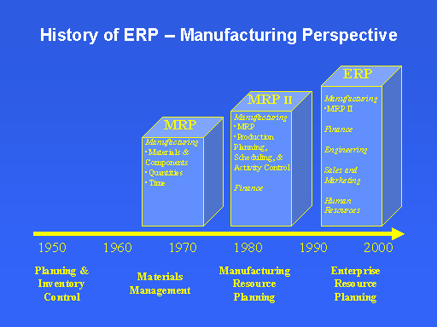
EVOLUTION OF ERP

Slide 21

Inventory Control
Inventory Control is the supervision of supply, storage and accessibility of items in order to ensure an adequate supply without excessive oversupply.

Slide 22
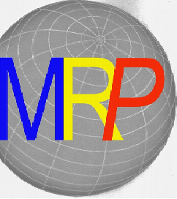
Material Requirements Planning
Material Requirements Planning (MRP) is a computerized inventory control and production planning system for generating purchase orders and work orders of materials, components, and sub assemblies.

Slide 23

Manufacturing Resource Planning (MRP II)
Manufacturing Resource Planning (MRP II) is an expansion of MRP, originating during the early 1980s.
MRP II helps to plan all the resources necessary for manufacturing; including financial analysis, feedback loops, and marketing plans.

Slide 24
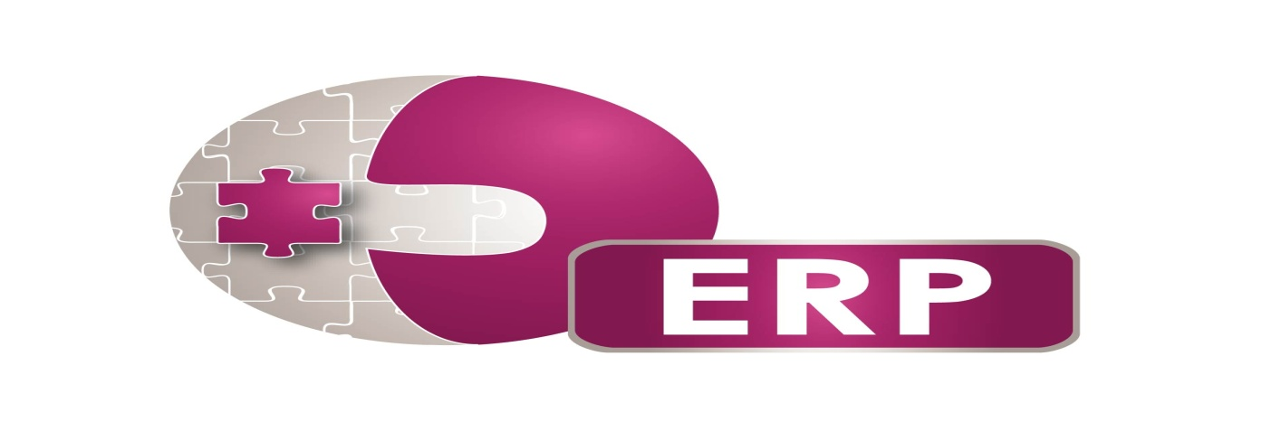
ERP
Today, ERP is the foundation system for domestic and global business operations, supporting most or all functional areas in their daily operations. For some organizations, ERP is a source of competitive advantage.

Slide 25
Risks of ERP
The implementation of ERP systems has been problematic for many organizations.
The implementation of ERP systems can be a monumental disaster unless the process is handled carefully. Some of the well-known and well-documented failure stories are that of Hershey Foods, Whirlpool, Dow Chemical, Boeing, Dell Computer, Apple Computer, etc.
Implementing an ERP project involves a certain amount of risk.
The ERP system cannot be implemented in a totally risk free environment.
The only thing that differentiates successful and flawed or failed implementations is the way in which the risks were anticipated, handled and mitigated.

Slide 26
Minimizing the Risks…
Prepare well—Meticulously plan each every step of the implementation.
Have a contingency plan—There will always be unexpected problems; you should have a plan for those situations.
Use a proven methodology—A methodology will help ward off risk, but a contingency plan is still absolutely necessary.

Slide 27
Risks of ERP
ERP implementations are notoriously resource intensive, highly complex, time consuming and unpredictable in terms of cost and hence very risky.
There are really three basic areas where problems can occur—people, processes and technology.
Of the three risk factors, people issues are the most critical.
People issues contributed to failed implementations in 69% of the case compared to process issues (18%) and technological issues (13%)

Slide 28
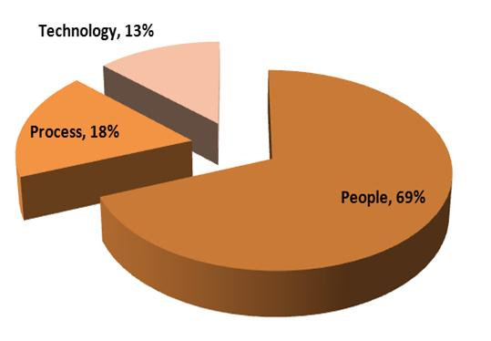
Risks of ERP

Slide 29

People Issues
People—employees, management, implementation team, consultants and vendors—are the most crucial factor that decides the success or failure of an ERP system.
The main people issues are:
Change management
Internal staff adequacy
Project team
Training
Employee re-location and re-training
Staffing (includes turnover)
Top management support
Consultants
Discipline
Resistance to change

Slide 30
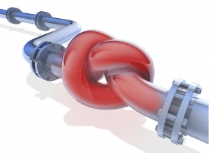
Process Risks
The ERP system will introduce hundreds of new business processes and will eliminate a lot of existing processes. Managing the implementation of the business processes is a factor that will decide the success of the ERP implementation.
The main areas of concern are:
Program Management
Business Process Reengineering
Stage Transition
Benefit Realization

Slide 31

Technological Risks
Keeping pace with the technological advancements is one of the very important issues that will determine the success of the ERP systems.
Some of the technological issues are:
Software Functionality
Technological Obsolescence
Application Portfolio Management
Enhancement and Upgrades

Slide 32
Managing Risks
Ensuring a smooth ERP migration is complex and every implementation involves a certain level of business and technical risk.
Managing risk on an ERP project is crucial to its success. A risk is a potential failure point.
The 5 steps to managing risk are:
Find potential failure points or risks
Analyze the potential failure points to determine the damage they might do
Assess the probability of the failure occurring
Based on the first three factors, prioritize the risks
Mitigate the risks through whatever action is necessary

Slide 33
Benefits of ERP
Installing an ERP system has many advantages—both direct and indirect.
The direct advantages include improved efficiency, information integration for better decision- making, faster response time to customer queries, etc.
The indirect benefits include better corporate image, improved customer goodwill, customer satisfaction and so on.
Some of the benefits are quantitative (tangible) while many others are qualitative (intangible).

Slide 34

Tangible Benefits of ERP
Inventory reduction
Inventory carrying cost reduction
Reduction of lead-time
Personnel reduction
Cycle time reduction
Productivity improvements
Other management improvements
Financial close cycle reduction
IT cost reduction
Procurement cost reduction
Cash management improvements
Revenue/profit improvements
Reduced quality costs
Improved resource utilization
Transportation/logistics cost reduction
Maintenance reduction
On-time delivery improvements

Slide 35

Intangible Benefits of ERP
Information visibility
New and improved business processes
Customer responsiveness
Improved supplier performance
Better customer satisfaction
Cost reduction
Integration of business functions
Information integration
Better analysis and planning capabilities
Improved information accuracy
Improved decision-making capability
Standardization of business processes
Flexibility and business agility
Globalization of the organization
Better business performance
Supply chain integration
Use of latest technology

Slide 36
DISADVANTAGES OF ERP
Takes time to implement.
Large amounts of workers have to shun their regular labor and undertake training.
This not only disturbs the regular functioning of the organization but also runs the organization in the huge risk of losing potential business in that particular period.
Expensive due to outside consulting, data analysis and conversion, training.
It leads to performance problems that is when people can’t do their jobs in familiar way and haven’t yet mastered the new way. This causes panic and business goes into losses.

Slide 37


Implementation Issues
Many ERP implementations fail because they do not consider the various implementation issues associated with a complex and risky project.
Some of these issues are:
Project Size
Lengthy Implementation Time
High Initial Investment
Unreasonable Deadlines
Insufficient Funding
Interface
Organizational Politics
Scope Creep
Unexpected Gaps
Configuration Difficulties

